Slide 1
Course Content Simplification Agent
CAPSTONE PROJECT
Presented By: C.Suravi
Student name: C.Suravi
College Name & Department :Presidency University (Computer Science & Engineering)
AICTE Student ID: STU682eb0bf7afe51747890367

Slide 2
OUTLINE
Problem Statement
Technology used
Wow factor
End users
Result
Conclusion
Git-hub Link
Future scope
IBM Certifications

Slide 3
Problem Statement
Many students struggle to understand academic content due to complex language or advanced terminology. Traditional teaching materials aren't tailored to each learner's knowledge level. The goal was to build an AI agent that simplifies academic content based on the user's proficiency (Beginner, Intermediate, Expert).
Proposed Solution: We built this agent on IBM Cloud using Watsonx tools and Granite foundation models to make learning easier for everyone.

Slide 4
Technology used
IBM Cloud Lite account
Watsonx.ai Studio
IBM Granite foundation model
Granite-3-3-8b-instruct model (used for content simplification)
IBM Cloud Object Storage
Vector Index for document-based Q&A
Built-in agent tools (retrieval, summarization, Q&A)

Slide 5
IBM cloud services used
Watsonx.ai Studio – to build and manage the AI agent
Watsonx.ai Runtime – for executing tasks using granite-3-3-8b-instruct
Cloud Object Storage – for uploading study materials and documents
Agent Lab – to configure, preview, and deploy the agent
Vector Indexing – for enabling document-aware question answering

Slide 6
Wow factors
Automatically rewrites complex academic content into simpler language based on the learner’s level.
Built using IBM’s powerful granite-3-3-8b-instruct foundation model for high-quality natural language understanding.
No coding required — fully built and deployed using Watsonx.ai's visual tools.
Supports document upload and vector-based retrieval for personalized Q&A.
Dynamic explanation switching (Beginner ↔ Expert) in real time.
Simplifies textbook paragraphs, class notes, or user prompts instantly.
Can be deployed and previewed as a usable agent with one click.
Provides a practical AI education use case for improving accessibility in classrooms.

Slide 7
End users
Students: To better understand difficult academic content in simpler terms.
Teachers: To create adaptive, easy-to-understand learning materials.
Tutors and Mentors: For providing individualized learning support.
Curriculum Designers: To assess and redesign content for inclusivity.
E-learning Platforms: To offer level-based content delivery.
Academic Support Teams: To assist students with different learning needs.
Special Education Programs: For tailoring explanations to students with learning challenges.

Slide 8
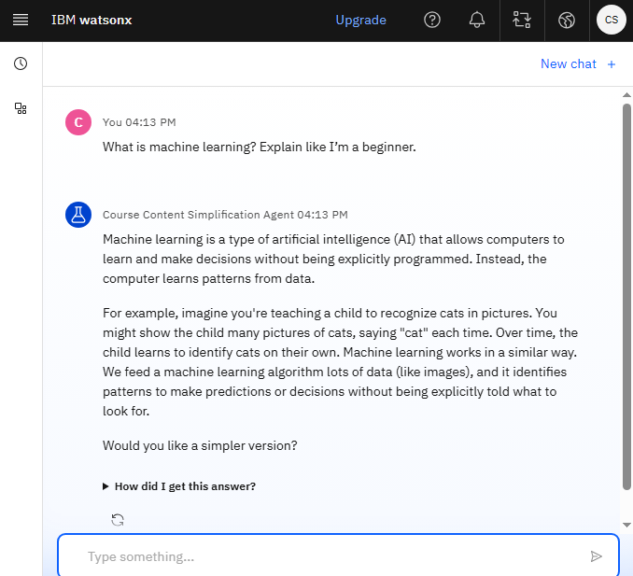
Results
Created the AI agent which responds based on user proficiency.

Slide 9
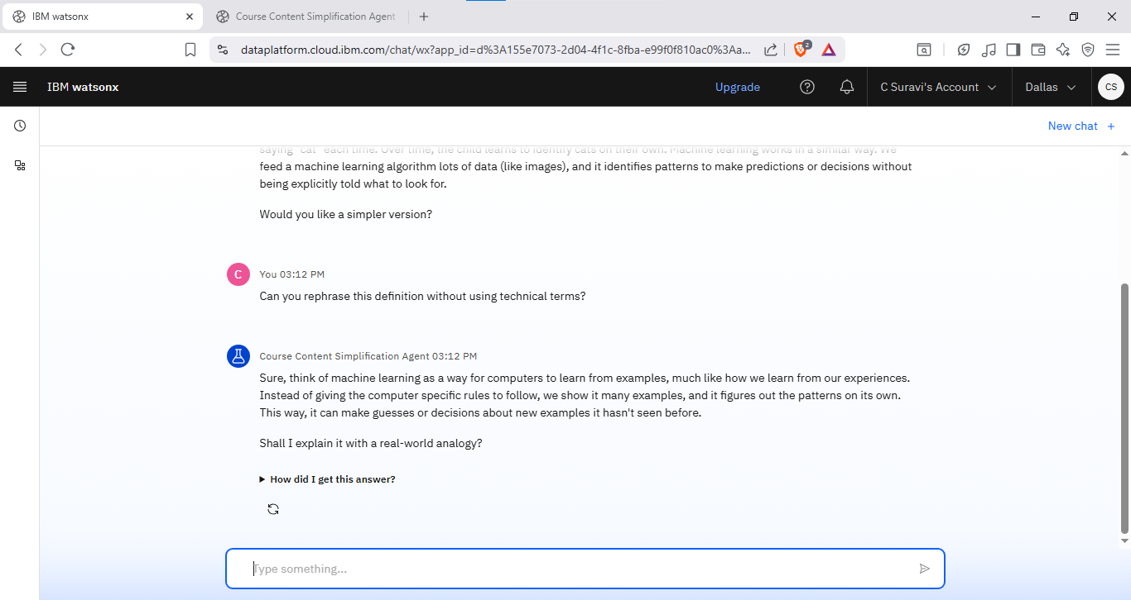
Results
Curates response based on user input.

Slide 10
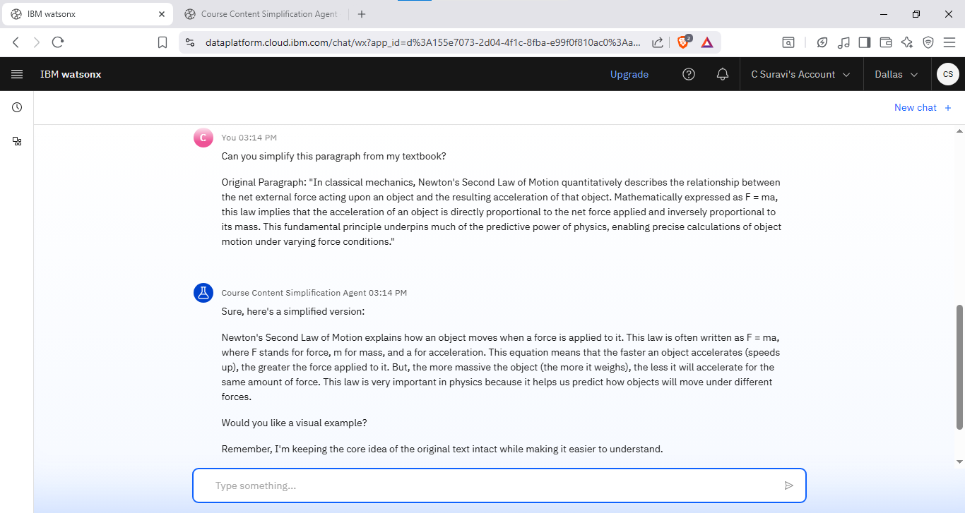
Results
Provides simplified response.

Slide 11
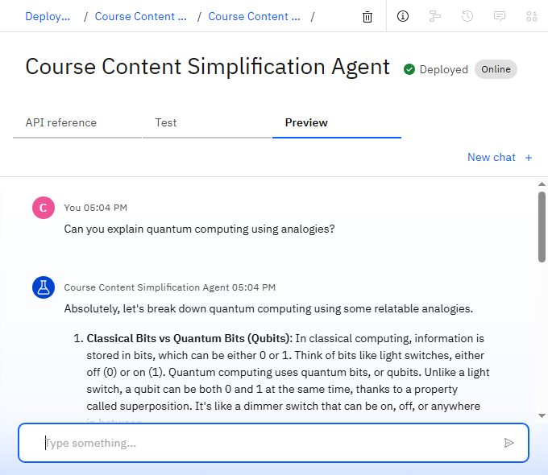
Results
Deployed Agent.

Slide 12
Conclusion
The Course Content Simplification Agent successfully simplifies academic material based on the learner's understanding level.
Built using IBM Watsonx.ai Studio and the granite-3-3-8b-instruct model, it provides real-time content adaptation without requiring any code.
The agent enhances personalized learning by responding dynamically to user input.
It improves comprehension, engagement, and accessibility in education.
The solution demonstrates how AI can support inclusive, student-centered content delivery.

Slide 13
GitHub Link
https://github.com/Suravi9740/Course-Simplification-Agent

Slide 14
Future scope
Add support for more subjects and topics
Provide answers in multiple languages
Allow saving simplified answers as text
Improve the accuracy of simplification
Make the chatbot available on websites or apps
Add memory to follow up on previous questions

Slide 15
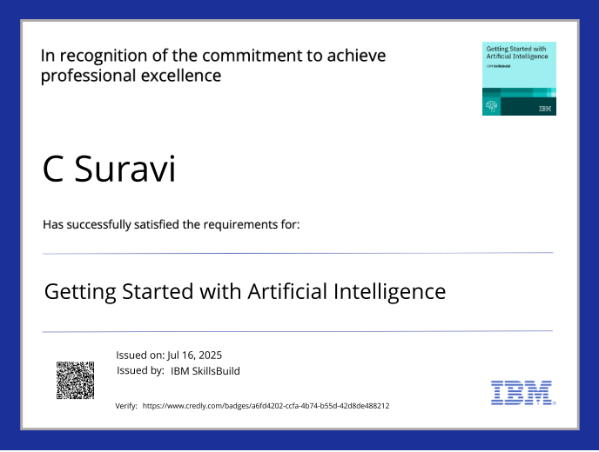
IBM Certifications

Slide 16
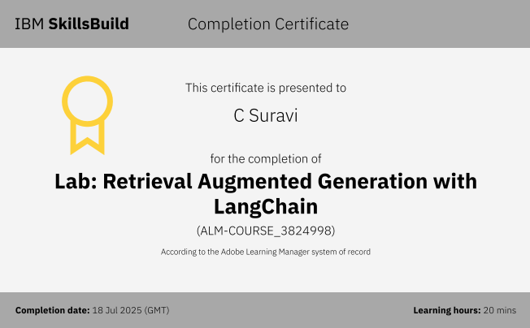

Slide 17
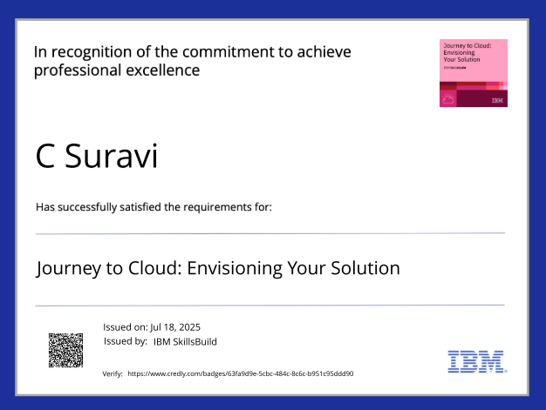

Slide 18
THANK YOU

